Slide 1


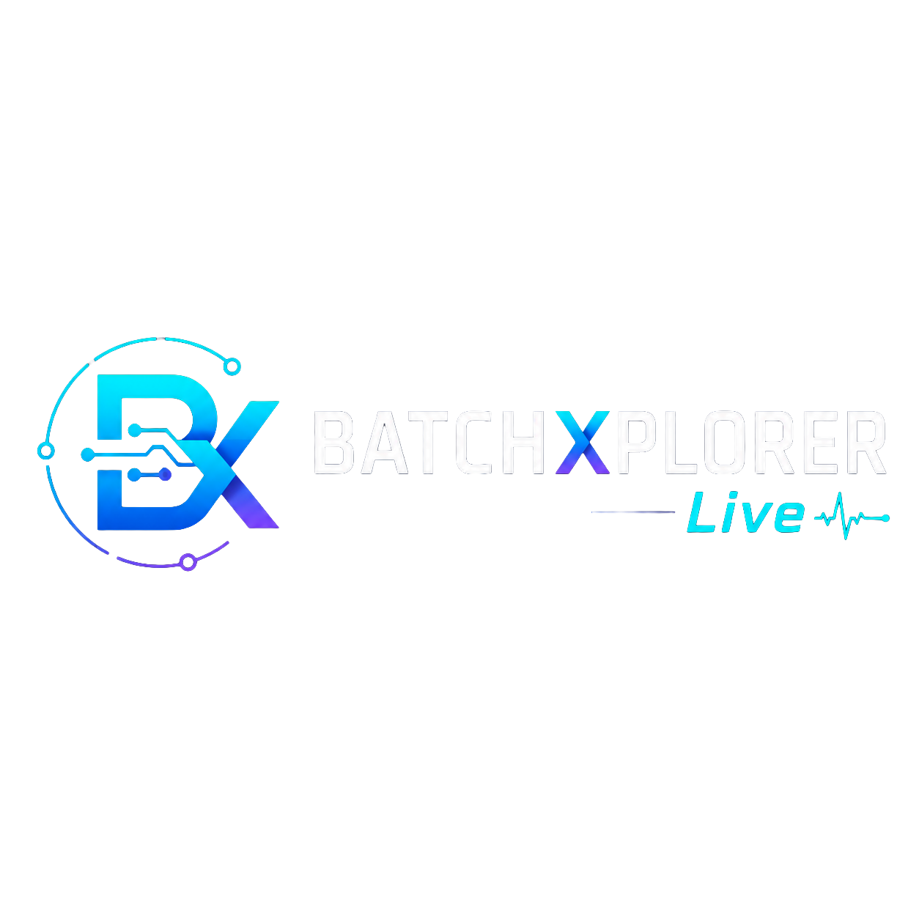
Live Batch Intelligence.
Validation-Ready by Design.
Accelerate your process development with the power of technology.

Slide 2
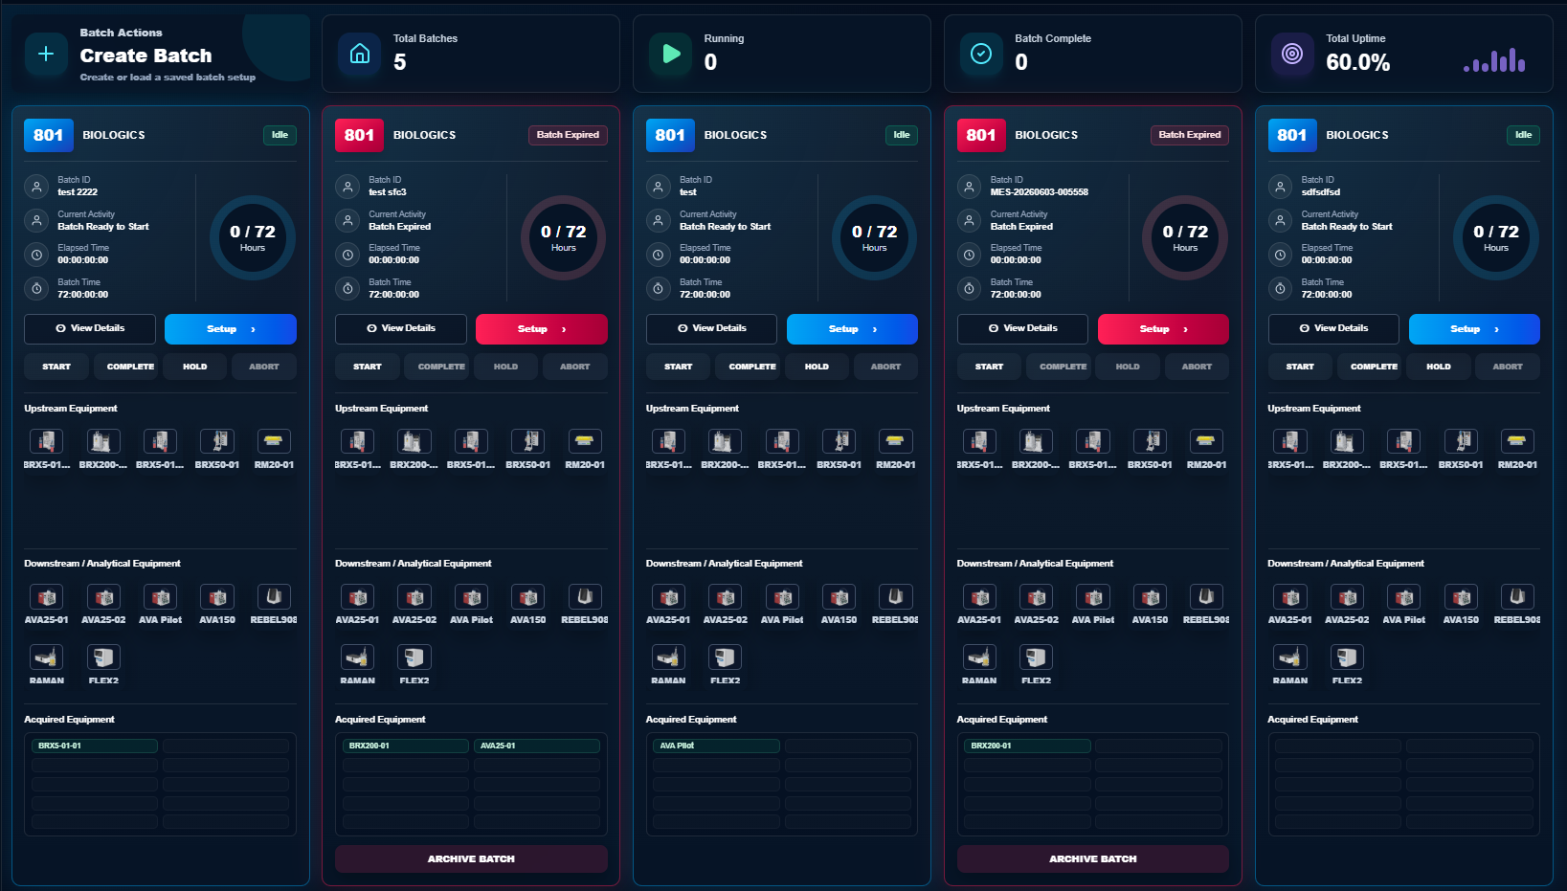
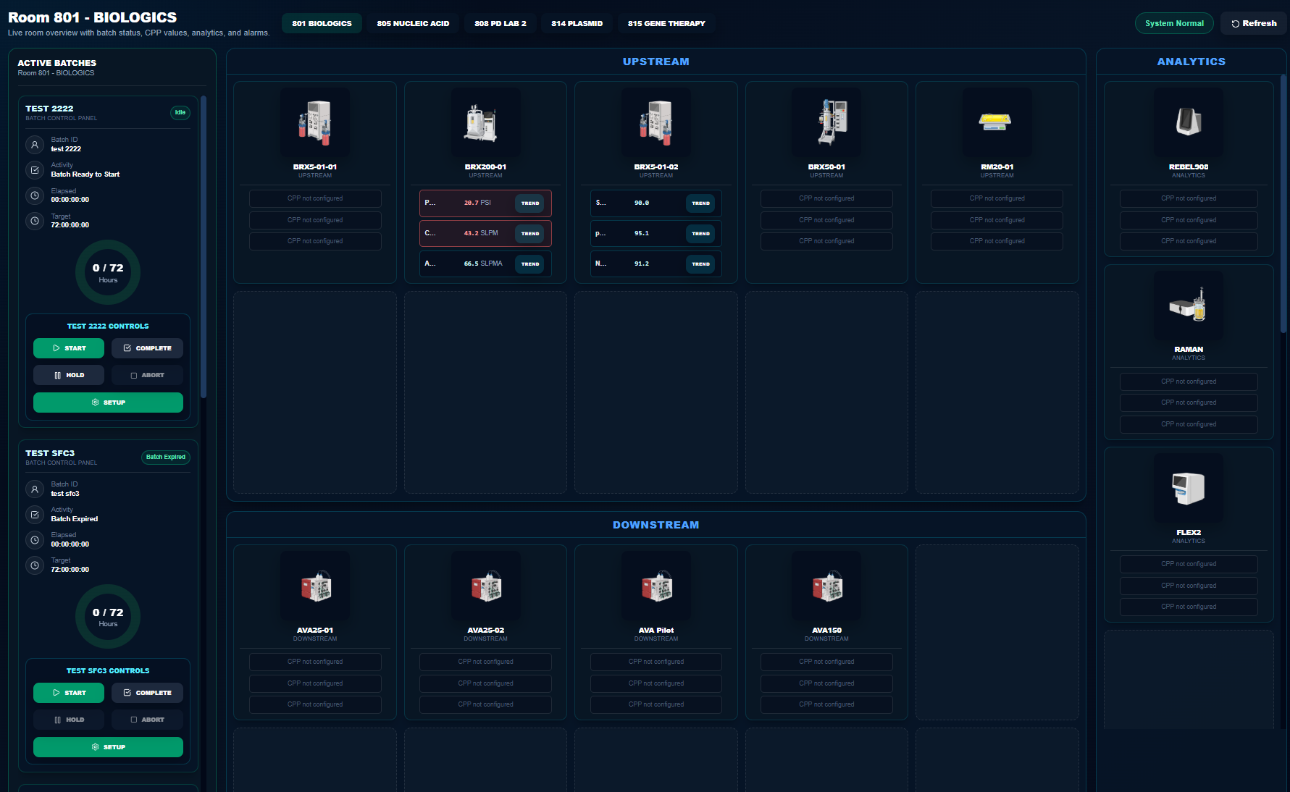
BATCHXPLORER LIVE
Validation-Aware Process Development Platform
CORE FEATURES
BATCHXPLORER LIVE PLATFORM
Validation-aware Batch Software for process development – built for GMP teams.
BATCHXPLORER Live is a configurable SaaS platform for GMP-oriented process development and small-scale production. It delivers process visibility across suites, modalities, and workflows while supporting batch recipes, free-run experimentation, controlled data capture, and consolidated reporting. The core product is deployed without customer-specific source-code customization; suites, equipment, recipes, tags, roles, reports, identity settings, and integrations are managed through controlled configuration. Built with electronic signatures, audit trails, controlled reports, and validation-aware release governance, BATCHXPLORER Live supports the technical controls needed for 21 CFR Part 11-aligned operations.
Live batch card dashboard view
Browser Based Application
No client install
IoT Edge Technology
Validation aware
Validation-Aware Controls
BATCHXPLORER Live provides Part 11-aligned technical controls, controlled reports, audit trails, electronic signatures, and validation-aware documentation scaffolding that can be re-baselined as the application evolves.
Live suite dashboard view
Process Development
Pilot Plants
Tech Transfer
Batch Scale Up
BATCHXPLORER LIVE | IoT Edge Hardware | MES/SFC workflows | Historian | Electronic Records | Validation-aware release governance

Slide 3
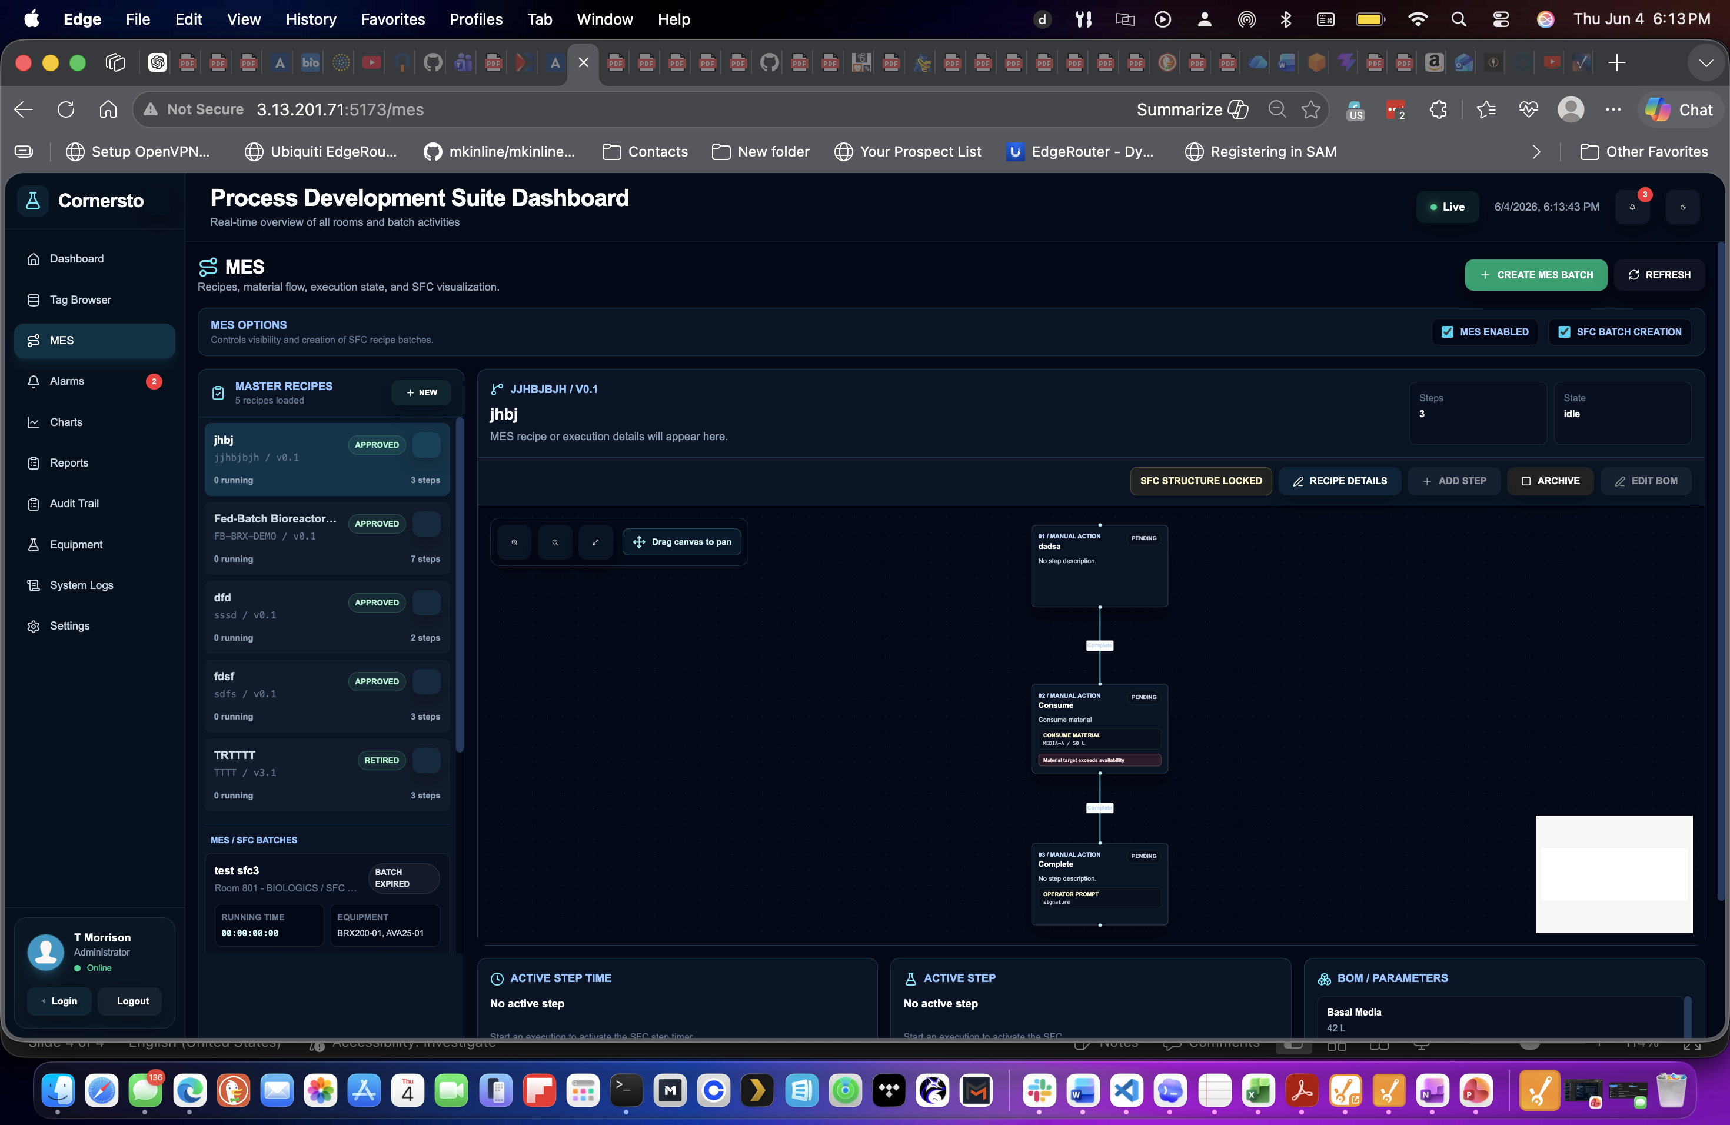
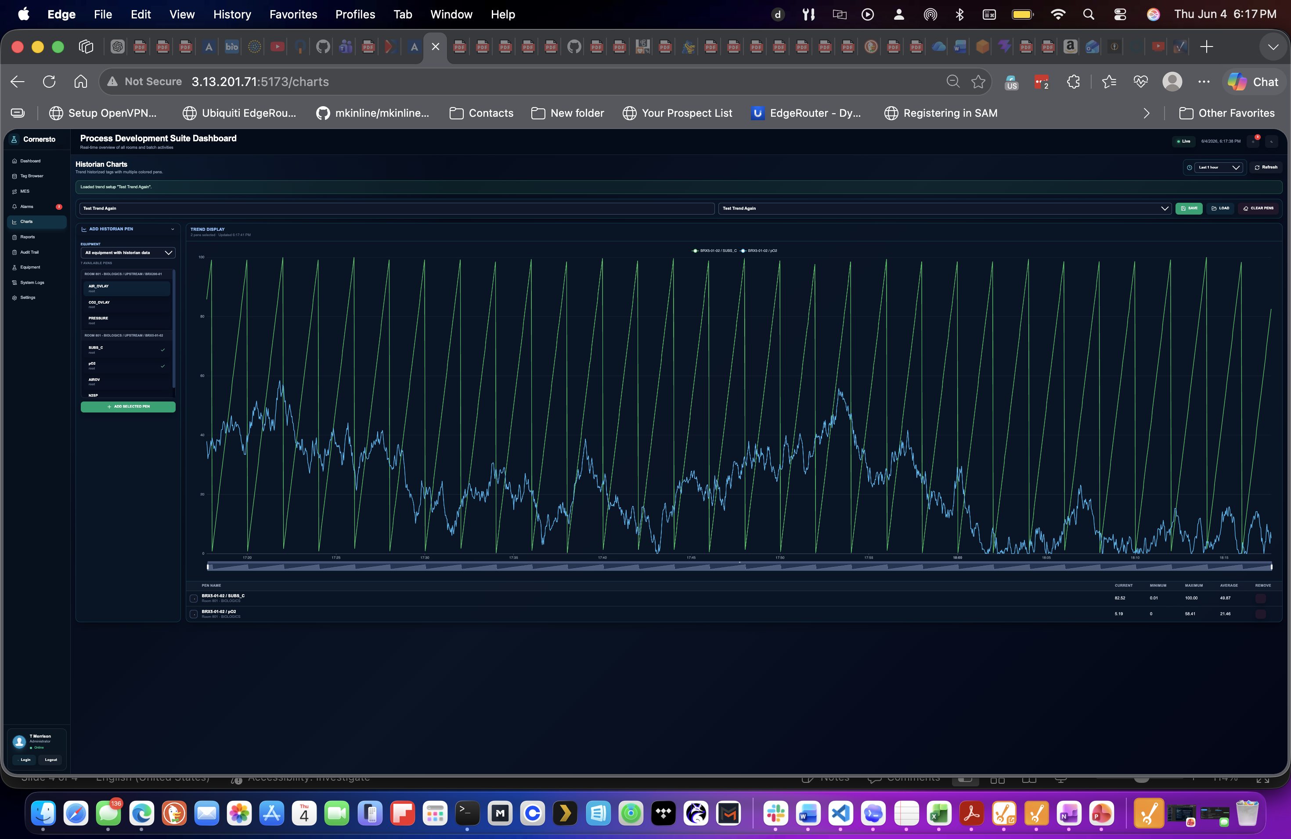
BATCHXPLORER LIVE
Validation-Aware Process Development Platform
PLATFORM CAPABILITIES
OPERATIONS AND EXECUTION
One Platform for visibility, MES workflows, historian review and GMP records.
Suite Dashboard
MES / SFC Workflows
Real-time visibility across rooms, batches, equipment status, alarms, and operating state.
Graphical recipes, execution flow, material consumption, operator actions and locked structures.
OPC UA
Modbus
Local config
Historical Analytics
Equipment Assets & Alarms
Multi-pen trends, saved setups, CPP review, batch context, and process intelligence.
Alarm review, equipment status, asset visibility, and operational exception support.
Live MES/SFC visual recipe execution
Reports & Audit Trail
Security & Electronic Signatures
Controlled report generation with review history, audit trail outputs, and true-copy support.
Security matrix, authority checks, electronic signatures, and role-based access controls.
The Difference
Default Operational modules are tied to configuration, baselines, impact assessment, and release governance – not isolated screens or disconnected documents.
Live trend tracking of continuous data.
BATCHXPLORER LIVE | IoT Edge Hardware | MES/SFC workflows | Historian | Electronic Records | Validation-aware release governance

Slide 4
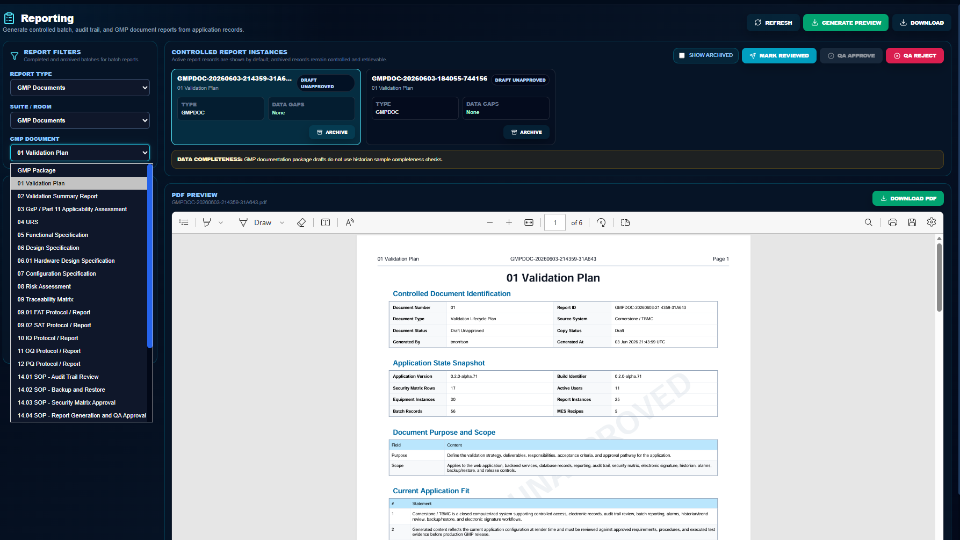
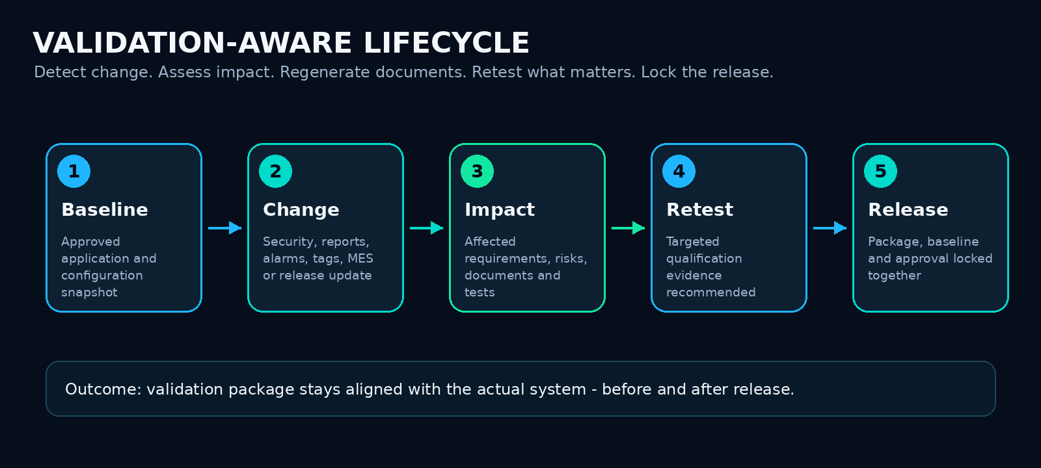
BATCHXPLORER LIVE
Validation-Aware Process Development Platform
CHANGE MANAGEMENT
CLOUD-FIRST DEPLOYMENT
Process Development Moves Fast. Validation evidence must keep up.
BATCHXPLORER LIVE runs as a browser-based SaaS application. A hardened IoT Edge device keeps a compact industrial gateway for local connectivity to equipment, protocol conversion, buffering, and secure outbound data movement.
Traditional Approach
BATCHXPLORER LIVE APPROACH
Configuration Change
Configuration Change Detected
Manual document change
Less manual consolidation. More confidence at release.
Close validation and change management gaps in real time.
Baseline compared
Manual RTM review
Impact Assessment Generated
OPC UA
Modbus
Local config
Manual retest detection
Affected Documents Refresehded
Validation drift risk
Retest scope Recommended
Released Locked
01 – Configuration Change Detected
02 – Compare Baselines
03 – Assess Impact / Refresh Docs
04 – Recommend Retest Scope
05 – Lock Release for QA Approval
BATCHXPLORER LIVE | IoT Edge Hardware | MES/SFC workflows | Historian | Electronic Records | Validation-aware release governance

Slide 5
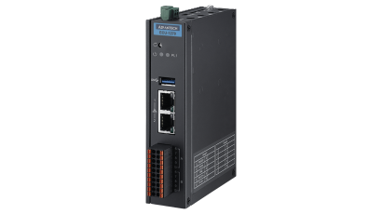
BATCHXPLORER LIVE
Validation-Aware Process Development Platform
INSTALLATION
CLOUD-FIRST DEPLOYMENT
No software installation for the users. Minimal hardware at site.
BATCHXPLORER LIVE runs as a browser-based SaaS application. A hardened IoT Edge device keeps a compact industrial gateway for local connectivity to equipment, protocol conversion, buffering, and secure outbound data movement.
EDGE GATEWAY
PROCESS
EQUIPMENT
SECURE MQTT OVER TLS
BATCHXPLORER
CLOUD APPLICATION
BROWSER BASED
ACCESS
Bioreactors,
Chromatography Skids,
TFF Skids,
Analytical Instruments
Outbound data transfer to cloud application
Each customer has its own segregated application instance and data repository.
No local software installation. Easy access to your data 24/7.
No desktop rollout
No site app server
Industrial Protocols Stay Local
Secure cloud connectivity
Lower IT burden
Minimal site footprint
Scale by site
Validation-aware lifecycle
Quick setup and ease of use
Application updates, UI access, reports and validation-aware functionality are centrally managed in the cloud.
Use a compact IoT edge gateway for local equipment connectivity. OPC UA, MQTT, serial or direct I/O integration is available out of the box.
Add suites, equipment, recipes, and reports without deploying a full application stack at each facility.
Cloud release governance, baselines, and impact assessment help keep documentation aligned with application changes.
Streamlined setup, remote commissioning, and validation-aware support to get your process-development workflow moving faster.
BATCHXPLORER LIVE | IoT Edge Hardware | MES/SFC workflows | Historian | Electronic Records | Validation-aware release governance

Slide 6
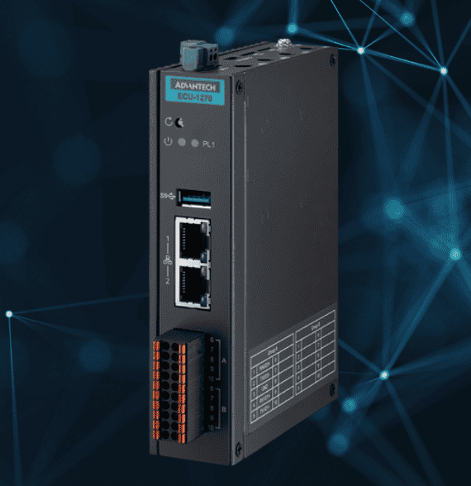
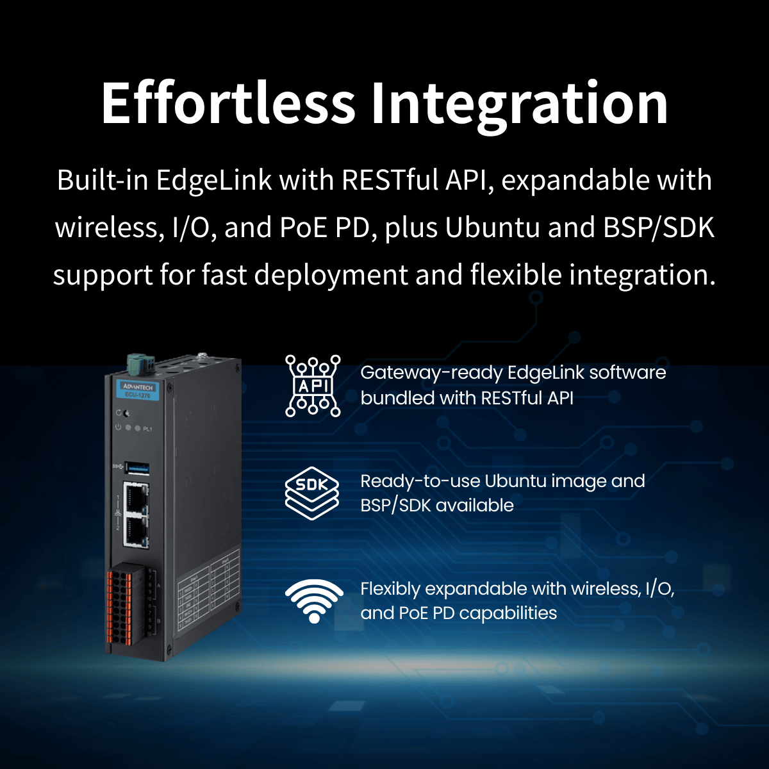
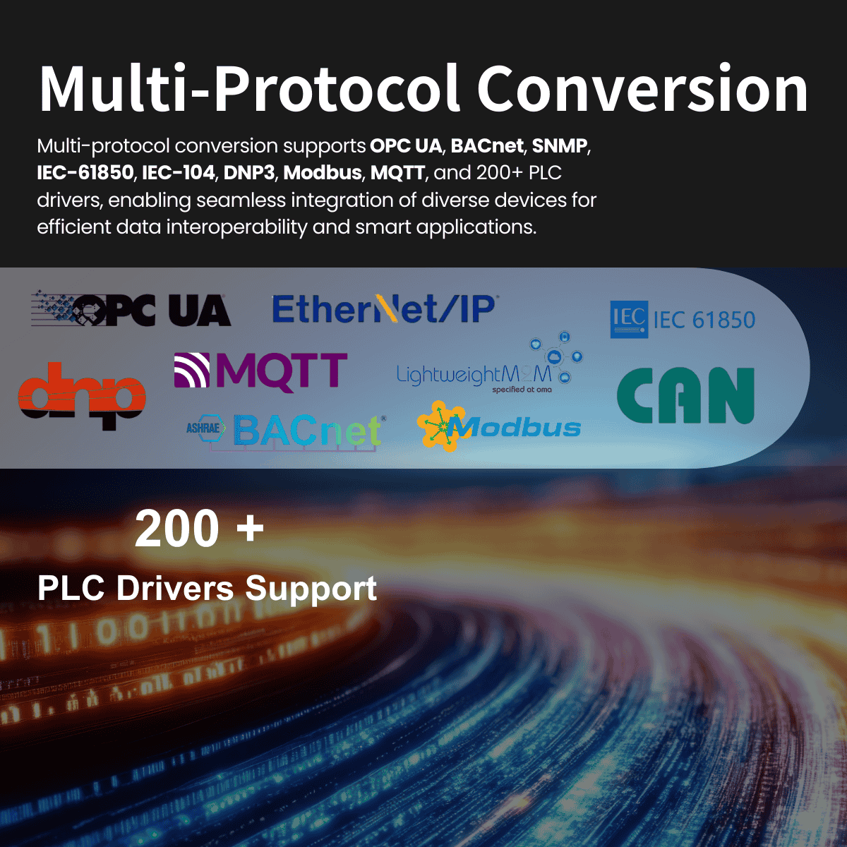
BATCHXPLORER LIVE
Validation-Aware Process Development Platform
EDGE IoT INTERFACE
OPERATIONS AND EXECUTION
Keep your industrial protocols and data at the edge. Send secure time-series continuous and alarm data to the cloud.
BATCHXPLORER LIVE keeps the industrial complexity where it belongs. The on-premise edge node supports OPC UA, Modbus, remote I/O, and other industrial drivers to meet equipment needs. Each node provides for up to 30 days of data buffering and the cloud application supports unlimited scaling of nodes.
OPC UA
Modbus
Local config
BATCHXPLORER LIVE | IoT Edge Hardware | MES/SFC workflows | Historian | Electronic Records | Validation-aware release governance

Slide 7

BATCHXPLORER LIVE
Validation-Aware Process Development Platform
BENEFITS AND OUTCOMES
OPERATIONS AND EXECUTION
Drive faster outcomes with a built-in quality mindset.
For teams requiring a digital process-development workflow with GMP-aware technical controls from day one, BATCHXPLORER Live provides a modern path from process visibility to validation-aware governance without a heavy-weight on-premise application stack or months of upfront validation/startup work.
Faster Implementation
Streamlined validation and startup
Ideal Applications
Browser based access, centralized app deployment, and minimal local hardware.
The system uses validation-aware baselines, impact assessment, and document scaffolding to keep evidence aligned with application changes.
Process development labs
Small-scale production
Pilot plants
Tech transfer
GMP manufacturing support
Moving from paper to Electronic Batch Records
Historian modernization
Cloud / Industry 4.0 modernization.
OPC UA
Modbus
Local config
No months-long rollout
Better batch process insight
No desktop application installation or bulk servers needed.
Combine batch dashboards, MES/SFC context, historian trends, and controlled reports to understand and refine your process.
Compliance Mindset
Flexible edge expansion
You are in control
Designed to support initiatives aligned with CFR Part 11, EU GMP Annex 11, GAMP 5, and ALCOA+ data integrity expectations.
Use common industrial protocols such as OPC UA, MQTT, and remote I/O with a compact on-premise gateway, or connect to existing OPC UA sources.
Keep documentation, approvals, SOPs, system configuration, and governance under your control with browser-based access to data and reports.
Request alpha access or schedule a demo
BATCHXPLORER LIVE
Visit batchxplorer.live or contact sales@batchxplorer.live to request alpha access, review your process-development use case, and determine the right package path after alpha.
IoT Edge Hardware | MES/SFC workflows | Historian | Electronic Records | Validation-aware release governance
BATCHXPLORER LIVE | IoT Edge Hardware | MES/SFC workflows | Historian | Electronic Records | Validation-aware release governance
7

Slide 8
PACKAGE PATH
Package ladder after alpha
Prove value in a 90-day alpha, then convert based on actual module usage, site scope, gateways, and support model.
MOST LIKELY PAID CONVERSION
FOUNDING ALPHA
PROCESS DEVELOPMENT STARTER
SCALE-UP / GMP OPS
Founding Alpha
Process Development Starter
PILOT PLANT PRO
Scale-Up / GMP Ops
Pilot Plant Pro
FREE / 90 DAYS
$1,500 / mo+
$7,500 / mo target
$4,500 / mo target
All modules exposed for qualified alpha teams. Use the alpha period to prove fit, collect feedback, and identify the correct paid package.
Entry package for one suite or focused process-development group that needs live context and controlled review.
Expansion package for regulated development, small-scale GMP, and scale-up teams that need stronger evidence governance.
Main conversion package for pilot-plant teams that need workflow context, multiple gateways, and Process Insight.
Qualified alpha users
Live run review and suite visibility
Process Insight preview
Structured feedback sessions
Conversion review before day 90
Up to 10 named users
1 edge gateway connection
20,000 tags per gateway
Free-run capture, charts, basic reports
Audit trail and equipment registry
Up to 50 named users
Multi-room / small-scale production
GMP package drafts and controlled evidence
Backup/restore evidence and system logs
Full Process Insight + CQA linkage roadmap
Up to 25 named users
Up to 3 edge gateway connections
Starter features + MES/SFC workflows
Process Insight baseline included
PI Web API connector launch promo / add-on
Edge Gateway Kit: $1,195 one-time
Enterprise / Network: custom quote
Includes provisioning and remote commissioning. 20,000 configured process tags per gateway.
Multi-site, private cloud/VPC, custom connectors, enterprise governance, and partner-led deployment.
On-site validation and installation support quoted separately by channel partners. Public website remains alpha-first; this slide supports qualification and proposal discussions.
8

Slide 9
OPTIONAL / APPENDIX
Partner / Channel Model
Scale reach without absorbing on-site validation, installation, and custom integration scope.
Referral & Co-Sell
Implementation / Validation Services
Enterprise / Network
• Register qualified alpha or paid opportunities before the sales process advances.
• Referral: 10% of first-year net SaaS ACV after close and payment.
• Partner-assisted co-sell: 15% of first-year net SaaS ACV when actively supporting discovery, demo, and data scope.
• Partners quote and keep their own services revenue for installation, CSV/validation support, historian/edge integration, and site work.
• SaaS subscription does not include on-site validation, customer SOP execution, or installation services.
• Edge Gateway Kit remains separately priced at $1,195 one-time unless otherwise agreed.
• Multi-site, private cloud/VPC, custom connector, or partner-led deployment packages remain custom quote.
• Reseller / VAR economics require a signed addendum; target margin or revenue share: 20%-25%.
• Optional renewal participation only if active partner-of-record support is documented.
Suggested economics
Referral
10% first-year net SaaS ACV
Co-sell
15% first-year net SaaS ACV
VAR / Reseller
20%-25% by addendum
Renewal
0% default / optional 5% active partner
Commercial guardrails
• BATCHXPLORER retains SaaS pricing, product claims, customer terms, IP, roadmap, and support control.
• Partners may not bind Theloris, promise custom source-code forks, guarantee compliance, or claim automated QA batch release / product disposition.
• Best-fit partners: automation SIs, historian/data consultants, CSV/validation consultants, life-sciences engineering firms, and process-development advisors.
BATCHXPLORER LIVE | Partner-enabled alpha → Pro / Scale conversion
9

