Slide 1
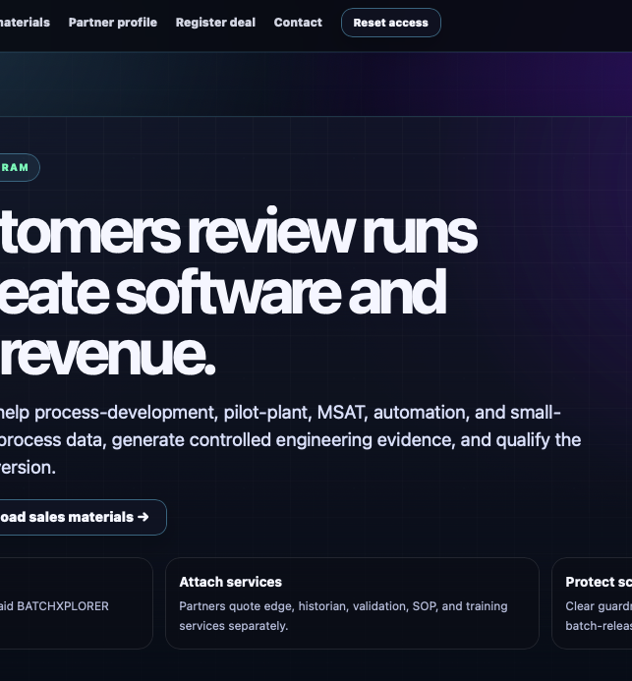

A partner model built for software + services
● CHANNEL PARTNER PROGRAM
Partners bring customer trust, technical delivery, and local support while Theloris provides the platform, packaging, and co-sell motion.
Help customers review
runs faster. Create
software + services
revenue.
Partner paths
Referral • Co-sell • Implementation / Validation • Enterprise / Network. Choose the path that matches your customer access and delivery capability.
What partners earn
SaaS referral or co-sell revenue, partner-owned services revenue, recurring support opportunities, and expansion/renewal upside.
BATCHXPLORER partners connect process data, scope real run-review pain, attach implementation and validation services, and qualify the right package for paid conversion.
What partners get
Partner workspace • sales materials • demo access • deal registration • package guidance • service-boundary templates • co-sell support.
Sell SaaS
Attach services
Protect scope
How we protect the channel
Referral and co-sell revenue tied to paid subscriptions.
Edge, historian, validation, SOP, training, and support services.
Guardrails prevent custom-source, free validation, and batch-release promises.
Deal registration, clear partner type, customer-fit review, no hidden custom-code obligations, and separate partner SOW for on-site services.
Partner motion: register deal → demo → package fit → services SOW → deployment → ongoing support
Next step: apply → onboard → register a deal → schedule demo → close and deploy
01

